Slide 1
MOVIE RECOMMENDATION SYSTEM By Kevinbhai Barvaliya (0785329) Under the Guidance of, Dr. Savita Seharawat

Slide 2
Introduction
Nowadays, the recommendation system has made getting the things effortlessly that we need. The main purpose of Movie recommendation systems is to help movie enthusiasts by suggesting what movie to watch without the hassle to have to go through the time-consuming process of deciding from a large collection of movies which go up to millions is tedious and confusing. In this paper, we aim to minimize the human effort by suggesting movies based on the user’s interests and preferences.

Slide 3
Type of Recommendation system
Collaborative Filtering.
This system identifies users with similar tastes and uses their opinion to recommend the same to other users with similar interests. It generates recommendations using information about rating profiles for different users or items. It has been implemented in different applications such as YouTube, Netflix, and Spotify. It is a widely used approach and is used as a part of the hybrid system

Slide 4
Type of Recommendation system
Content-Based Filtering.
Content-based filtering methods are done based on user characteristics. This method is used in situations where data is known on an item such as name, location, or description and not on the user. It predicts the items based on the user’s information and completely ignores contributions from other users as with the case of collaborative techniques.

Slide 5
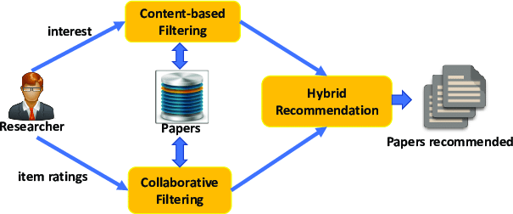
Type of Recommendation system
Hybrid Approach.
A hybrid approach is a combination of collaborative filtering content-based filtering or any other approaches. Hybrid approaches can be implemented by making predictions separately on content-based and collaborative-based approaches and later combining them. It increases the accuracy and performance of the recommender systems.

Slide 6
Methodology

Slide 7
Implementation of Movie Recommendation System

Slide 8
Data mining
Scrapped 150k movies data from IMDb web site using python script.
Fetched following features: Movie name, Rating, Released year, Metalcore, Genre, Movie description, Movie certificate, Votes, Goss, Director name, Actors name, Time, etc.
Required module.
→ Beautiful Soup
→ Requests
→ Pandas

Slide 9
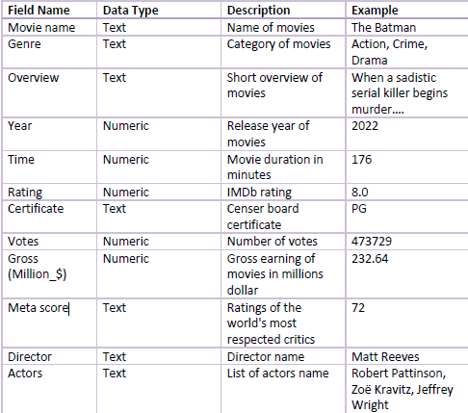
Data Dictionary

Slide 10
Data cleaning & transform
Overview column contains lots of forwarding spaces, so we remove those spaces using strap() function.
There are some roman data instead of year in the Year column, so we replace roman number will none data
Replacing comma commas with none from Time column.
some directors' names merged into the actor's column, so we must move those director name from actor column to director column.
Removed duplicated records.
After cleaning data, we are exporting Data Frame as CSV.

Slide 11
Exploratory Analysis
Exploratory Data Analysis refers to the critical process of performing initial investigations on data so as to discover patterns, to spot anomalies, to test hypothesis and to check assumptions with the help of summary statistics and graphical representations.
It is a good practice to understand the data first and try to gather as many insights from it. EDA is all about making sense of data in hand, before getting them dirty with it.

Slide 12
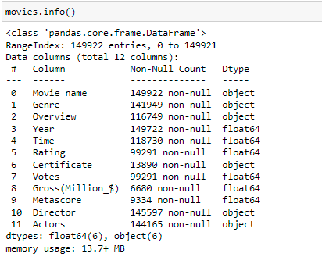
Checking details of data set

Slide 13
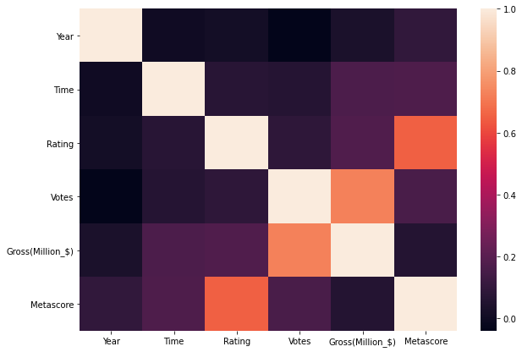
Correlation graph

Slide 14
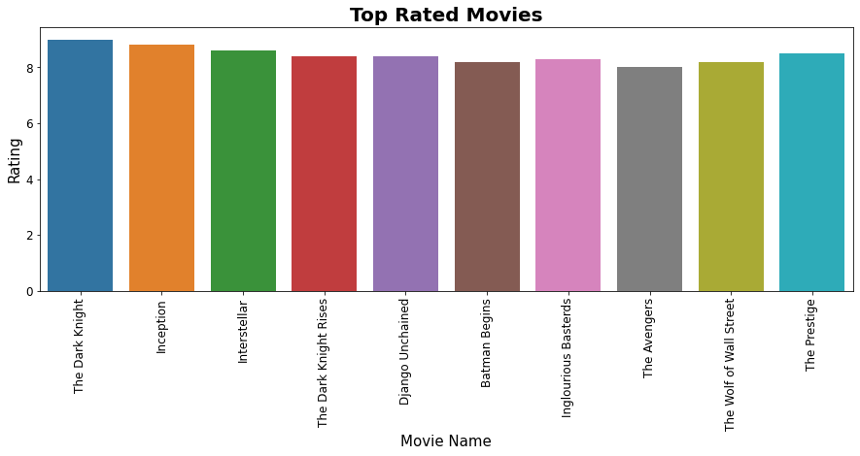
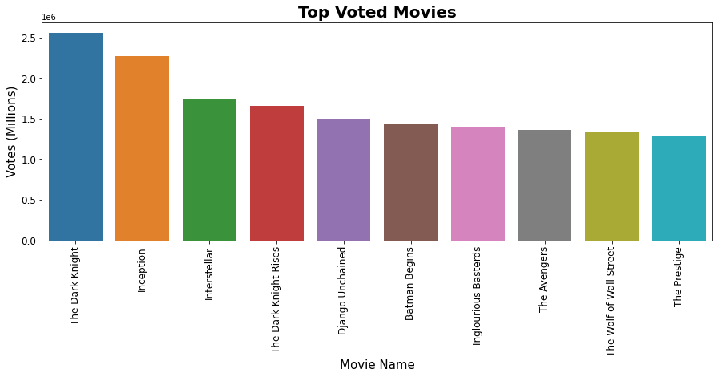
Top Rated & Top Voted movies

Slide 15
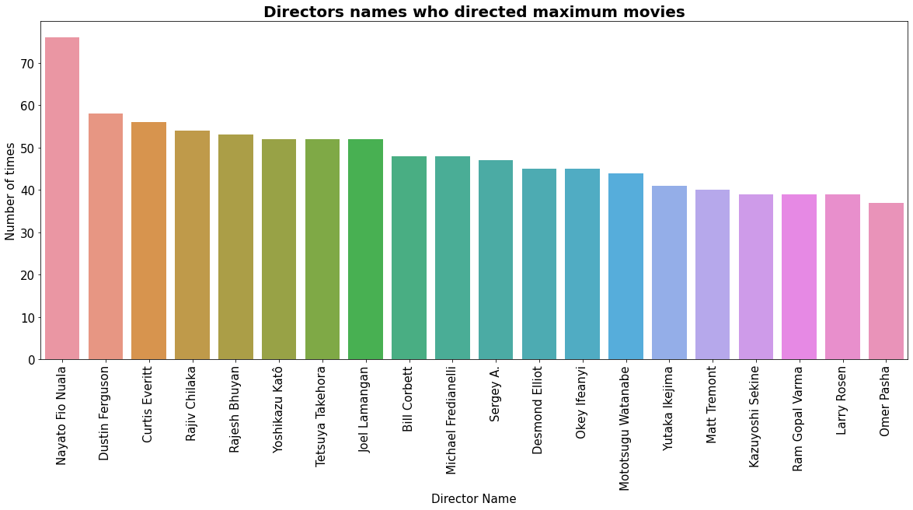
Director’s name who has directed maximum movies

Slide 16
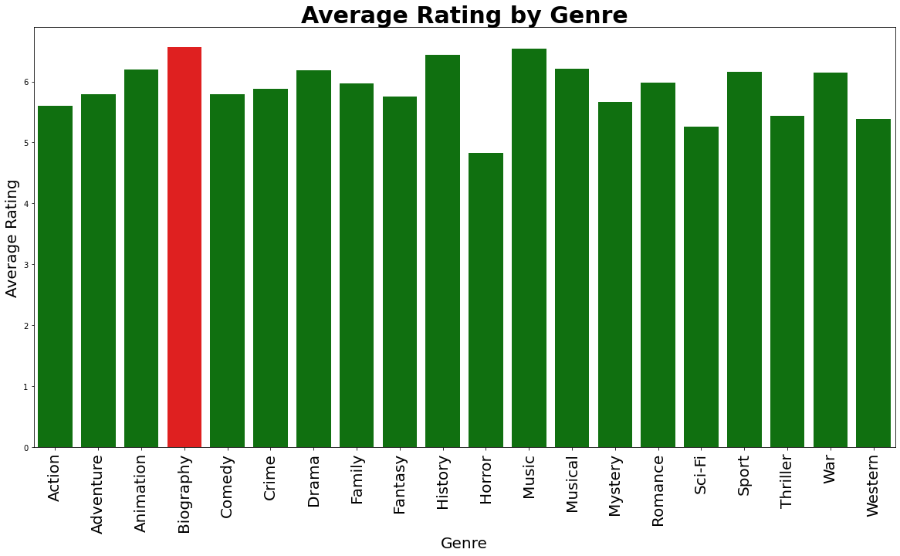
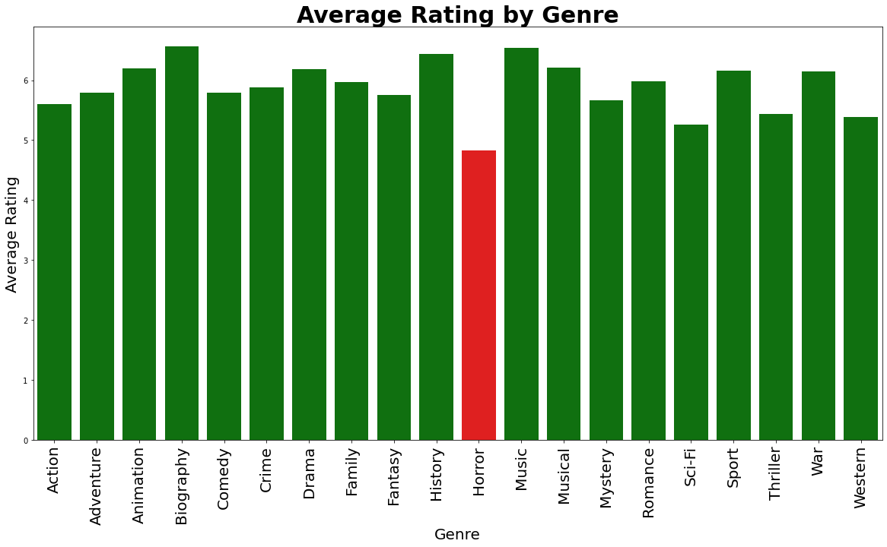
Ratings by Genre

Slide 17
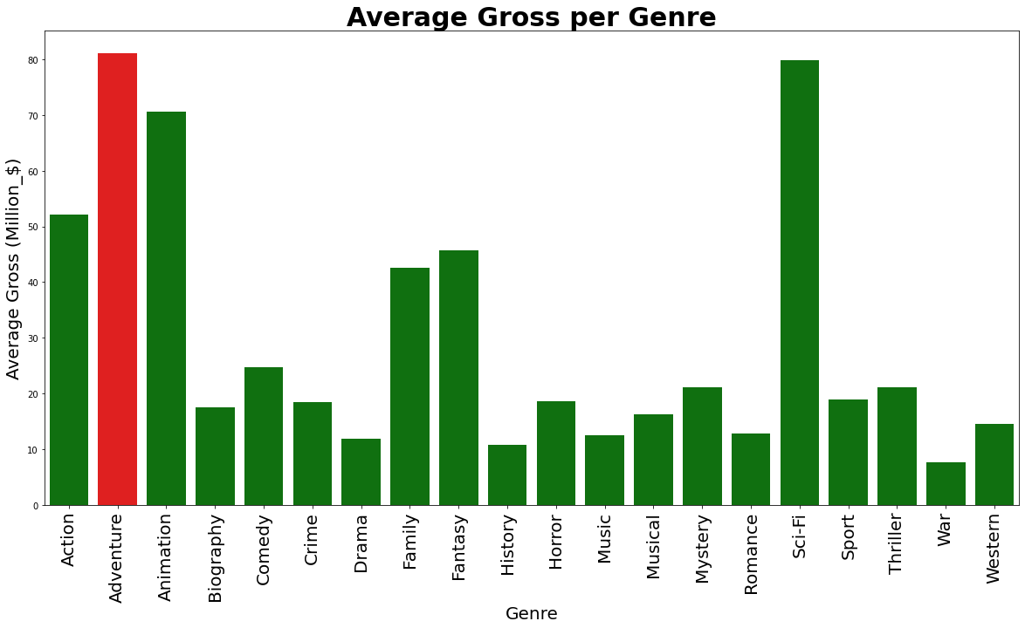
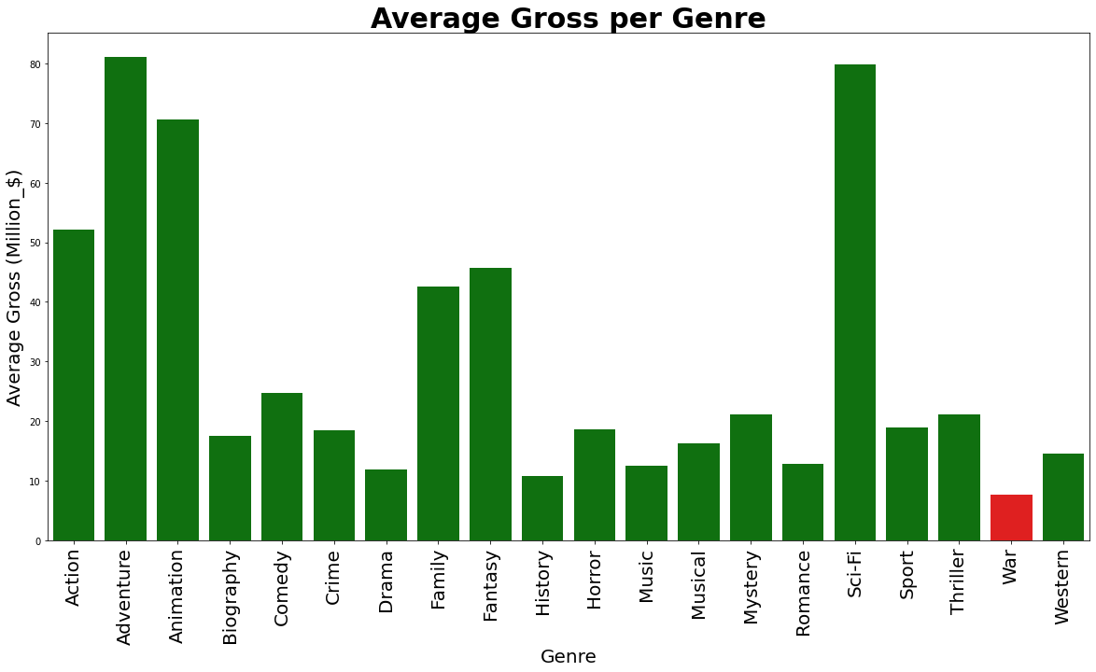
Average Gross per Genre

Slide 18
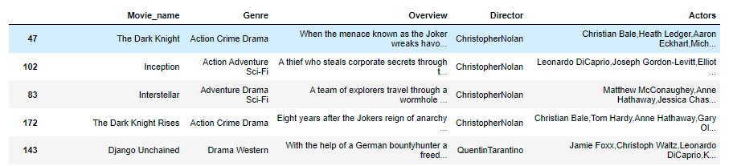
Feature selection
In this project we are implementing content bases recommendation, so we need features witch contains text data

Slide 19
Clean selected features
Genre: most of movies has more than one genre separated with comma, so we will replace comma with single space, because special characters might be affect to accuracy of recommendations.
Overview: This column contains short description about movies. This column also contains some special characters, so we will use python code which remove all the special characters and keep only text and numbers.
Director: First name and last name of director’s are separated with single space. We will remove this space and merge both as a single word. If we keep it separate then it might give less accurate recommendation because many directors have same first name as well as last name, it might be confusing to find similarity.
Actors: This column has same issue as director column, we will merge first name and last name of actors. In addition, this column contains multiple actors name and each name separated with comma, so we replaced this comma with none same as genre column.

Slide 20
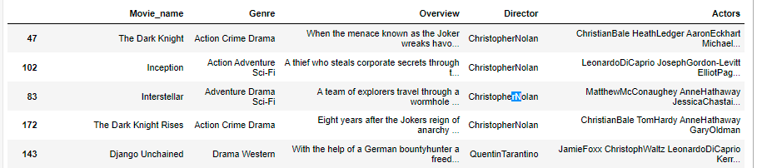
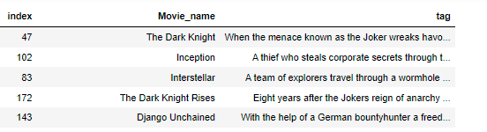
Merge columns

Slide 21
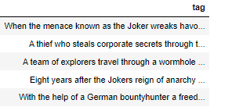
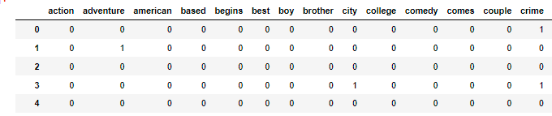
TF-IDF CountVectorizer
TF-IDF is an abbreviation for Term Frequency Inverse Document Frequency. This is very common algorithm to transform text into a meaningful representation of numbers which is used to fit machine algorithm for prediction.
Term frequency is defined as the number of times a word appears in a document.

Slide 22
TF-IDF CountVectorizer
TF-IDF is an abbreviation for Term Frequency Inverse Document Frequency. This is very common algorithm to transform text into a meaningful representation of numbers which is used to fit machine algorithm for prediction.
Term frequency is defined as the number of times a word appears in a document.

Slide 23
Cosign Similarity
Cosine similarity measures the similarity between two vectors.
It is measured by the cosine of the angle between two vectors and determines whether two vectors are pointing in roughly the same direction.
It is often used to measure document similarity in text analysis.
Cosine Similarity is widely used in Data Science and Machine Learning applications. Examples include measuring the similarity of:
Documents in natural language processing
Movies, books, videos, or users in recommendation systems
Images in computer vision

Slide 24


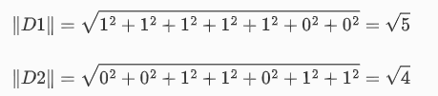

How to Cosign Similarity
First, we calculate the dot product of the vectors:
Second, we calculate the magnitude of the vectors:
Finally, cosine similarity can be calculated by dividing the dot product by the magnitude

Slide 25
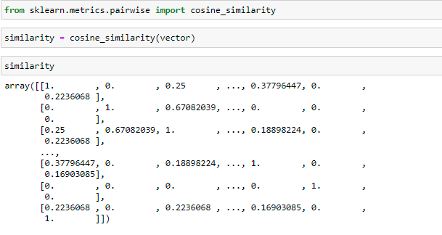
Cosign Similarity (Cont.)

Slide 26




Recommend movies
User enter name

Slide 27
Thank You!

